Slide 2
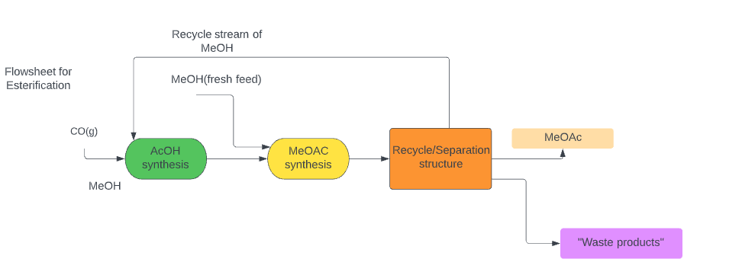
Route 1: Esterification

Slide 3
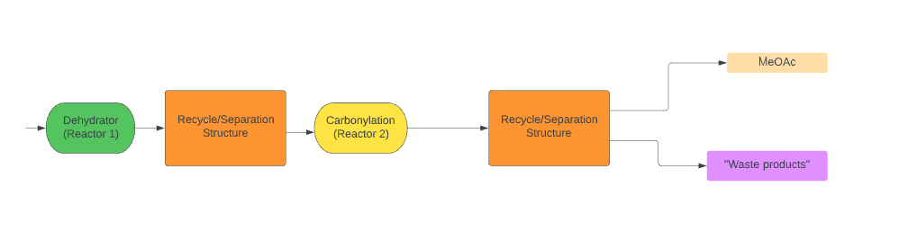
Alternative Pathway

Slide 4
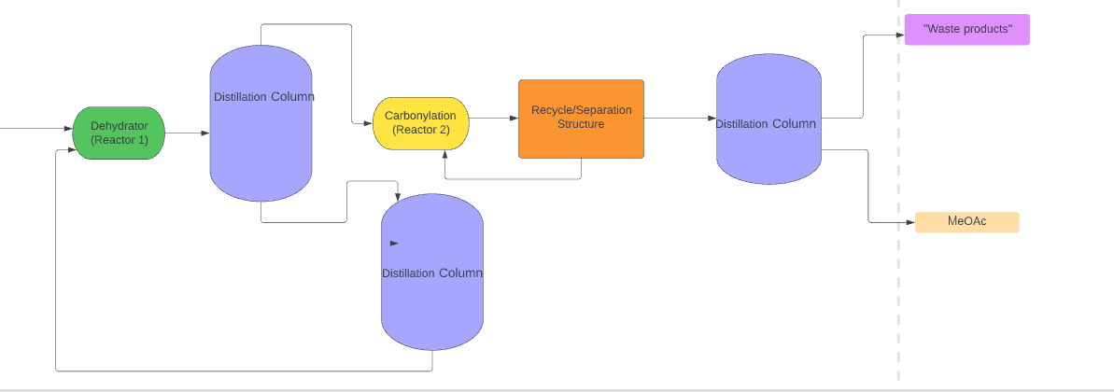
Alternative Pathway: Separation System shown

